Slide 1


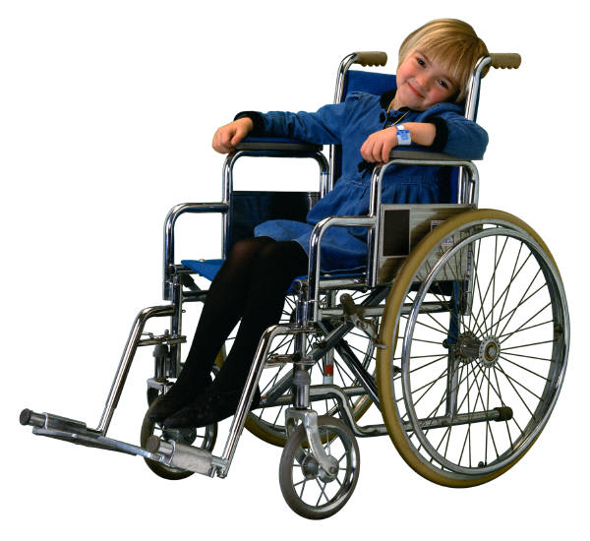
Disaster Preparedness and Response for Families With Special Needs
Mary Tello-Pool

Slide 2


Objectives
Identify hazards and assess needs
Learn how to evacuate or shelter-in-place
Learn about the different types of shelters
Learn how to develop, practice and maintain a family disaster preparedness and response plan
Learn how to assemble a disaster supplies kit
Learn how to be…and stay informed

Slide 3
Preparedness
“Always plan ahead. It wasn't raining when Noah built the ark.
”Richard C. Cushing

Slide 4


Individual & Family Preparedness
Preparedness begins with you!
Prepare with your family
Prepare with your neighbors
Prepare with your workplace
Prepare with your children’s schools and daycare
Prepare with your church
Prepare as a community.
You are a vital link to your Community Preparedness

Slide 5
Special Needs Preparedness
Special Needs may include: Visually impaired, hearing impaired, mobility impaired, single working parent, non-English speaking persons, people without vehicles, people with special dietary needs, people with medical conditions, people with mental retardation, and people with dementia.
Special needs children may include: technology dependent, developmentally disabled, have psychiatric/behavioral illnesses, be immunocompromised, have chronic diseases, or acute episodic illnesses
If you or someone close to you has a disability or a special need, you may have to take additional steps to protect yourself and your family in an emergency. Find out about special assistance that may be available in your community. Register with the office of emergency services for assistance so needed help can be provided.

Slide 6
Special Needs Preparedness
To be prepared for an emergency, children with special needs, the elderly and persons with disabilities require a little extra planning.
Preparedness is a continuous cycle of planning, practicing, evaluating and improving activities –the reason you practice is to test your plans.
In order to keep your family safe in an emergency, it is important to plan in advance what you will do.
Review your immediate surroundings, and take note of whatever you have on hand to take care of yourself and your loved ones.
Plan to function without outside support for 72 hours or longer
Think about the places where your family spends time: school, work and other places where you might be when a crisis happens. Ask about their emergency plans. Find out how they will communicate with families during an emergency. If they do not have an emergency plan, consider helping develop one.

Slide 7

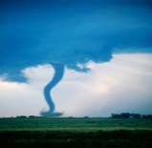
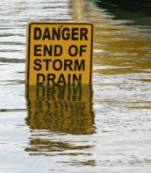
What Could Happen in Your Area ?
Find out what types of disasters could happen…take an all-hazards approach (Flood, tornado, blizzard, power outage, chemical spill, etc.).
Learn how to prepare for each…evacuate or shelter-in-place
Review your immediate surroundings, and take note of whatever you have on hand to take care of yourself and your loved ones.
Learn what your community’s warning signals sound like and what you should do when you hear them….sirens
Ask about animal care during and after disasters. Animals may not be allowed inside emergency shelters due to health regulations.
Find out how to help special needs persons.
Find out about the disaster plans at your workplace, your children’s school or daycare center and other places your family spends time.

Slide 8



Disasters
What is a disaster?
Anything that causes human suffering or creates
human needs that the victim can not alleviate themselves.
Some people Panic….
…While those with plans remain calm.

Slide 9
Types of Disasters
Natural and Manmade Disasters that could happen in your community.
Ice/snow storm Tornado Flood
Earthquake Riots Fire
Air Crash Hail Train Derailment
Power Failure Gas Leaks Hostage Event
Water Shortage Industrial Accident Explosion
Acts of Terrorism School/Work Shooting

Slide 10
Evacuate or Shelter-in-Place?
Depending on your circumstances and the nature of the attack, the first important decision is whether you stay put or get away. You should understand and plan for both possibilities.
Listen to your local news/weather station for instructions.
Evacuate instructions will include time, route, shelters, & etc
Shelter-in-place instructions will include time, safest place in your home, & etc.
Once you know which action is recommended…listen to your local news and follow your disaster plan.
Notify your family contact.

Slide 11
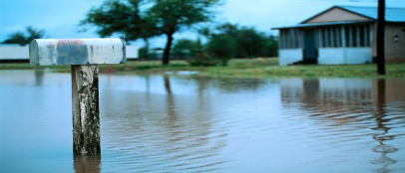
Evacuating Your Home
Plan to stay with family or friends in an unaffected area.
Plan to stay in a community shelter (Community Shelters are operated by the American Red Cross in partnership with local emergency management, public health, & other partners).
  If you choose to stay in a community shelter, you must find out community shelter rules and amenities:
  No Smoking, alcohol, or weapons
  Meal times
  Sleeping arrangements
  Bathing facilities
  Pets (service animals only)
  Special needs equipment
Plan to bring your own supplies when you evacuate (documents, cash, etc).

Slide 12
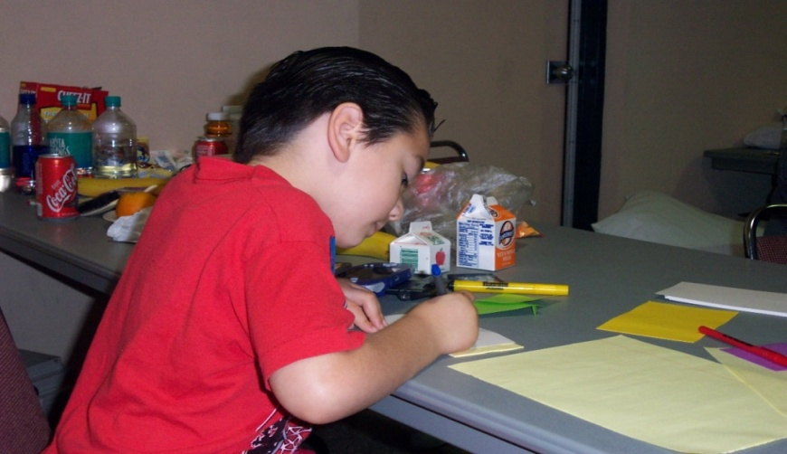
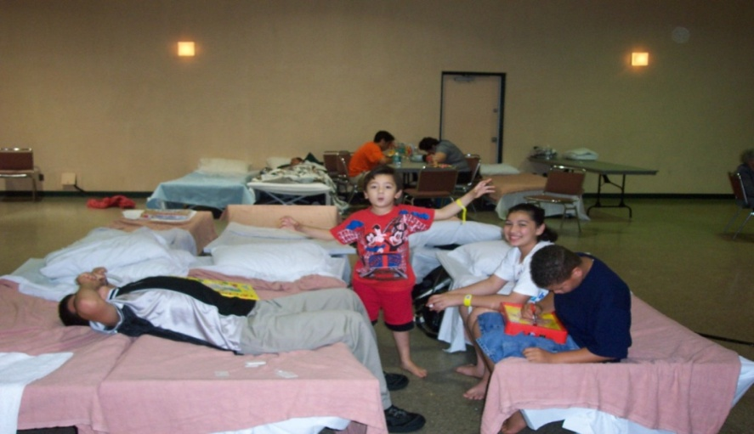
Children in Shelters
Children should not be separated from family
Children need activities
Children need reassurance
Children need security

Slide 13
ITEMS TO BRING WITH YOU TO A SHELTER
Insurance policies, contracts, wills, passports, deeds, social security cards, immunization cards, Medicare/Medicaid cards (keep in a water-proof bag)
Photo identification and proof of address
Emergency Contact Information: names and phone numbers of those in your personal support net-work, family members, doctors, equipment suppliers, and utility companies
Flashlight with extra batteries
Toiletries
Pillow
Change of clothes and hard soled shoes
Cell phone w/ spare batteries
Money (small bills and change)
Auxiliary medical equipment with extra batteries if necessary (i.e., oxygen, scooter, hearing aid)
Style and serial numbers of medical devices (such as pacemakers) and instructions for the devices
Medicine supply/list of medications and dosage instructions
Cane, crutches, walker or wheelchair
Glasses with repair kits and contacts with cleaning supplies

Slide 14

Shelter-in-Place
Shelter-in-place during:
Severe weather (blizzard, tornado, thunder/lightening storm)
  Stay away from windows and heavy furniture
  Listen to radio for instructions
  Follow your plan
Chemical spills (train derailment, explosions, etc)
  Plan to shelter-in-place for up to 72 hours without outside help.
  Listen to radio for instructions (taping windows & doors, etc).
  Follow your plan.

Slide 15
Create a Disaster Plan
Meet with your family and talk about why you need to prepare for a disaster.
Explain the dangers of fire, severe weather and floods to children.
Plan to share responsibilities and work together as a team.
Pick two places to meet: outside your home… and outside your neighborhood in case you cannot return home. Make sure everyone knows the address and phone number of the place where you plan to meet.
Ask an out-of-state friend or family member to be your “family contact.” All family members should call this person and tell them where they are.
Talk about what you will do for evacuation…or…sheltering-in-place

Slide 16

Create and Complete a Checklist
Keep emergency telephone numbers by phones.
Teach children how and when to call 911.
Show each family member how and when to turn off the water, gas and electricity.
Make sure you have adequate insurance coverage.
Teach each family member how to use the fire extinguisher, and show them where it is kept.
Install smoke detectors on each level of your home, especially near bedrooms.
Look around your home for possible hazards.
During a disaster, ordinary objects in your home can cause injury or damage. Anything that can move, fall, break or cause a fire is a home hazard. For example, a hot water heater or a bookshelf can fall. Inspect your home at least once a year and fix potential hazards. Contact your local fire department to learn more about home fire hazards.

Slide 17

Checklist Continued…
Make a family plan, stock emergency supplies and assemble an emergency supply kit.
Determine the best escape routes from your home. Find two ways out of each room.
Find the safe spots in your home for each type of disaster (tornado, chemicals)
Make two photocopies of vital documents and keep the originals in a safe deposit box. Keep one copy in a safe place in the house, and give the second copy to an out-of-town friend or relative. (copy to CD or jump-drive and keep in your to-go bag)
Take a complete photo inventory of your home, garage and surrounding property. This list could help you prove the value of what you owned if your possessions are damaged or destroyed and can help you to claim deductions on taxes.

Slide 18
Checklist of Important Documents
  Insurance policies
  Mortgage/leases/contracts
  Birth certificates
  Passports/alien documentation
  Occupational licenses
  Family medical information
  Unpaid bills
  Any other irreplaceable papers

Slide 19

Practice and Maintain Your Plan
Practice your plan and quiz your family every six months so they remember what to do.
Conduct fire and emergency evacuation drills.
Replace stored water, stored food, and stored batteries every six months.
Test and recharge your fire extinguisher(s) according to manufacturer’s instructions.
Test your smoke detectors monthly and change the batteries at least twice a year
Review and re-stock supplies when you set your clocks forward or backward

Slide 20

Prepare Emergency Supplies
Water
Keep at least a three-day supply of water per person; each person will need a gallon each day (same for pets)
Children, nursing mothers, and sick people may need more water
Store water tightly in clean plastic containers such as soft drink bottles
Food
Store at least a three-day supply of non-perishable food
Select foods that require no refrigeration, preparation or cooking and little or no water
Pack a manual can opener, paper cups, plates and plastic utensils

Slide 21


Emergency Supplies cont…
Ready-to-eat canned meats, fruits and vegetables
Protein or fruit bars
Dry cereal or granola
Peanut butter
Dried fruit
Nuts
Crackers
Canned or boxed juices
Non-perishable pasteurized milk
High-energy foods
Food for infants
Food for pets
Comfort/stress foods

Slide 22


Emergency Supplies cont…
Battery-powered radio
Flashlight
Extra batteries
Whistle to signal for help
Dust mask or cotton t-shirt, to help filter the air
Moist towelettes for sanitation
Wrench or pliers to turn off utilities
Plastic sheeting and duct tape to shelter-in-place (chemicals)
Garbage bags and plastic ties for personal sanitation

Slide 23


Emergency Supplies cont…
Paper towels
Matches or lighter in a waterproof container
Feminine supplies
Personal hygiene items
Copies of important family records in a waterproof portable container
Infant formula and diapers
Pet supplies
Extra pair of glasses or contact lenses
Cash
Cell phone

Slide 24
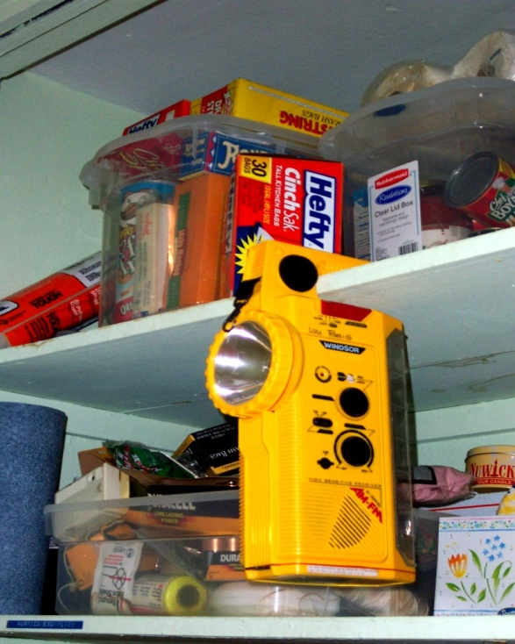
Emergency Supplies cont…
Keep disaster supplies together as much as possible and make sure everyone in the family knows where they are.
Use a closet, garbage bin, rubbermaid tote, large duffle bag, etc. to store your supplies.
It is best to store supplies in containers that are easy to move if you need to evacuate.

Slide 25
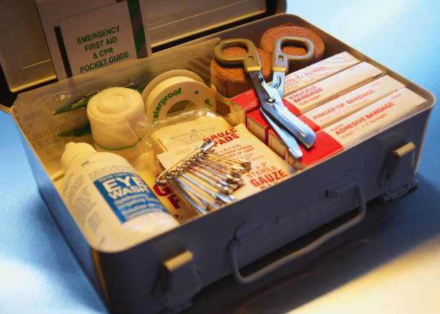

Prepare a First Aid Kit
In any emergency, a family member may be cut, burned or suffer other injuries. If you have basic supplies you are better prepared to help your loved ones when they are hurt.
Many injuries are not life threatening and do not require immediate medical attention.
Knowing how to treat minor injuries can make a difference in an emergency.
Consider taking a first aid class, but simply having the following things can help you stop bleeding, prevent infection and assist in decontamination.

Slide 26
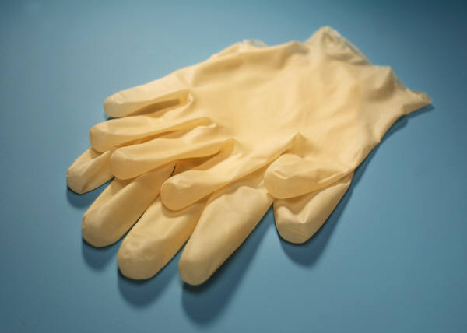

First Aid Supplies
First Aid book or guide
Sterile gloves
Sterile dressings to stop bleeding (roller gauze)
Soap and antibiotic towelettes to disinfect
Antibiotic ointment to prevent infection
Adhesive bandages in a variety of sizes
Eye wash solution to flush the eyes
Thermometer, scissors, tweezers
Prescription medications you take every day (you should periodically rotate medicines to account for expiration dates) (every 6 months when you replace water & batteries)
Prescribed medical supplies such as glucose and blood pressure monitoring equipment and supplies
Non-prescription drugs (aspirin or non-aspirin pain reliever, anti-diarrhea medication, antacid, vitamins, & etc.)

Slide 27

Special Needs Supplies
Ask your doctor about storing prescription medications such as heart medication and insulin.
Hearing aid needs
Mobility aid needs
Batteries for equipment
Medication needs

Slide 28
Individuals With Special Needs
Plan emergency procedures with home health care agencies or workers. Tell others where you keep your emergency supplies.
Wear medical alert tags or bracelets to help identify your disability.
Label equipment such as wheelchairs, canes and walkers.
Additional supplies include:
A list of prescription medications including dosage and any allergies
Extra eye glasses and hearing-aid batteries
A list of the style and serial numbers of medical devices such as pacemakers
Extra wheelchair batteries and oxygen
Copies of medical insurance cards
A list of doctors and emergency contacts

Slide 29
Individuals With Special Needs cont…
Have all durable medical equipment routinely inspected for state of repair, especially at the beginning of a “season”
Be able to troubleshoot all durable medical equipment
Make advance arrangements with suppliers in case of advance notice of threat
Keep copy of all medical records in a safe place but portable

Slide 30

Be…and Stay Informed
Seek Emergency information from credible and reliable sources (don’t buy into “hype”)
Local Emergency Management
Community Access Television
Local Emergency Television Station
Local Emergency Radio Station
Local Public Health Agency

Slide 31
We Are All In This Together
Know and help your neighbors
Meet new people
Volunteer your services in the shelter
Take turns with child care
Expect and forgive stressed behavior

Slide 32

Summary
Know your Risk Factors (assess needs)
Make a Plan (evacuate or shelter-in-place)
Build a Kit (emergency supplies for up to 72 hours)
Be Informed (credible sources)

Slide 33
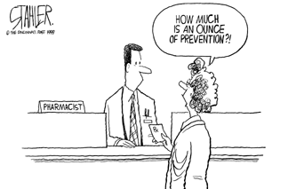
Questions????
Prevention

Slide 34
Sources and Resources
www.americanredcross.org
www.ready.gov
Local Emergency Management
Local Public Health

